Slide 1

Lecture 1
Fundamentals of
Ethical Hacking
Ethical Hacking
Diploma in IT
Year 3 (2021/22), Semester 1
Notes:
Left-hand Bar – Replace FSP by your module code and X by the lecture number.
Replace Lecture Title
Replace < Module Name >
Replace Year and Semester if necessary

Slide 2
Learning Objectives
Students will be able to perform the followings in Ethical Hacking and Penetration Testing:
Discuss the differences between EH and Pen-Test.
Explain the difference of the different types of Pen-Test.
Discuss each Phase in the Pen-Test Process Model.
Discuss the limitations of Pen-Test and implications.
Discuss the implication of legal process related to Pen-Test.

Slide 3
Contents
Ethical Hacking vs. Penetration Testing
Purposes of Pen-Testing
Types of Pen-Test
Focus of EH Module
Our Pen-Test Process Model
Public Testing Methodologies
Limitations of Pen-Test
Legal Issues
Code of Ethics

Slide 4
Ethical Hacking vs. Penetration Testing
Ethical Hacking | Penetration Testing
Using computer attack techniques to find security flaws in the targeted asset with the permission of the asset owner and the goal of improving the security of the asset. It may not necessary follow a process model or sequence of activities to hack into an asset. | Following a process model to locate and establish targets, find vulnerabilities, exploit the flaws to determine potential impact and business risk with the goal of helping the owner improve security practices. It has to be carried out under a controlled and safe manner according to a carefully designed scope and rules of engagement pre-established between the Pen-testers and the owner.

Slide 5
Pen-Test and Ethical Hacking may have some similarity. The terms are often inter used by many to refer to the same thing.
Pen-Test consists of “Security Assessment” or “Vulnerability Assessment” activity.
Went deeper with the goal of taking over systems and obtaining data.
Pen-Test is not a “Security Audit”. Audit is checking/policing according to the company’s security policy statement.
E.g. Staff are not allow to connect any personal wireless AP into any of the company’s network outlet.

Slide 6
Scope Document
This document establish a clear and explicit scope of a test
Discuss WHAT are to be tested
Address WHAT should be explicit avoided
Additional entity discovered during test
Outside the original scope and need to check with client
Will affect project timeline and cost
Extreme care needed if test on Production environment
More complicated if test involved shared cloud(public cloud) service
Explicit permission from the cloud company needed.

Slide 7
Rules of Engagement
Define HOW the test to be carried out.
Method for exchanging information(e.g. password and test outcomes etc.) in encrypted manner
Daily debriefing to limit surprises, discuss the following also:
Schedule and milestones
Significant issue discovered
Any stuff detected when the Pen-Test is going on.
Agreed date and time for testing
Announced or unannounced test?
How to deal with shunning of test traffic for unannounced test?
Explicitly include emergency contact information
Black box or crystal box test or hybrid approach?
Confidentiality of data on hacked systems
A good set of rules of engagement will facilitate test and make test more thorough and effective.

Slide 8
Purpose of Pen-Test
To find the vulnerabilities before the bad guys do and carry out destructive acts.
To make a point to decision makers about the risk and the need for action or resources.

Slide 9
Types of Pen-Test
Wireless Network Security Testing
Network Penetration Testing
System Penetration Testing
Web Application Testing
Social Engineering Testing
Physical Environment Testing
…

Slide 10
Types of Pen-Test focused in EH
Wireless Network Security Testing
Network Penetration Testing
System Penetration Testing
Computing Devices
Mobile Devices

Slide 11
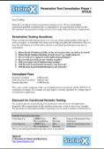
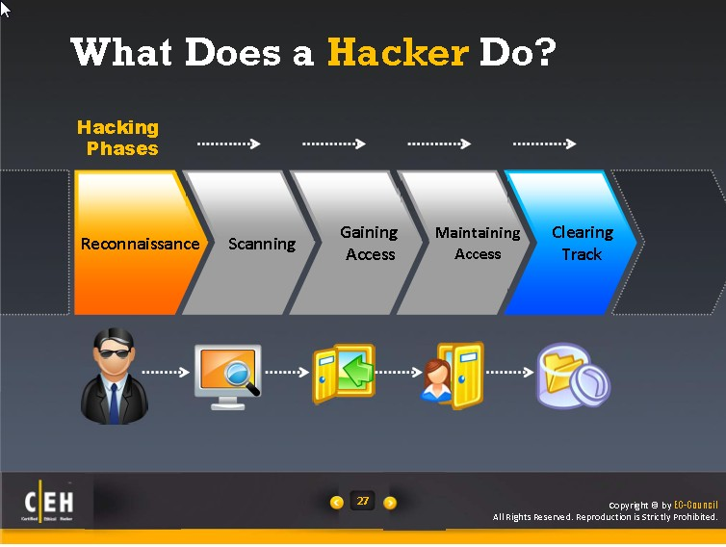
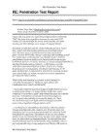
Pen-Test Process
Planning
Reconnaissance
Scanning
Exploit Systems
Reporting

Slide 12
Planning
When engaged in a Pen-Test, proper legal contract needs to be drawn up and signed-off by both parties.
The contract at the minimum must comprise of the following:
Client Info.
Test Team Info.
Scope of Pen-Test
Rules of Engagement
Cost
Limitations of Liability
The test team or company provides the service also need to arrange for Liability Insurance plus Errors and Omissions Insurance.

Slide 13
Reconnaissance
Research and information gathering to learn more about the target.
Organization people and culture
Terminology used by people in the organization
Details of the infrastructure
Internet, Intranet, remote access, extranet and private cloud(if any).
Also known as “Footprinting”
Aim to create a near complete of the target’s security posture without sending a single packet to the target’s systems.
Obtain valuable information such as
List of IP blocks and addresses, web servers, DNS servers, mail servers …
Employee names, email address, phone numbers etc.

Slide 14
Scanning
Scanning is equivalent to inspecting the walls for doors and windows as potential entry points.
Determine which devices and services are listening for inbound network traffic and are reachable.
Probing the identified services more fully for known weaknesses/vulnerabilities.
Involve active connection to systems and direct queries.
Level of intrusiveness is greater and maybe logged or otherwise noticed.

Slide 15
Exploitation
Exploitation(or Penetration) is a process involves gaining access to devices.
An exploit is code that a threat uses to take advantage of a vulnerability.
Pen-Tester can escalate privileges to obtain complete control of the system.
Post Exploitation
What Pen-Tester could do after the target system has been exploited:
Read files from target machine
Reconfigure target machine
Moves files to target machine
Install software on target machine
Use target machine as a pivot point to get deeper inside the network
…

Slide 16
Reporting
Necessary things that the report should consist of are:
Executive Summary
Detailed Findings
Risk level of the Vulnerabilities found
Business Impact
Recommendations
Conclusion
Appendices
Detailed vulnerability scan output
Updated official documents (If any)
Correspondences with client and any other third parties
Any other helpful items.

Slide 17
Public Testing Methodologies
(References)

Slide 18
Open Source Security Testing Methodology Manual (OSSTMM)
Free at www.isecom.org/osstmm
Useful broad descriptions on categories of test, includes template for information gathering.
Penetration Testing Execution Standard(PTES)
Available at www.pentest-standard.org
Great outline of an in-depth penetration test
Technical Guide to Information Security Testing and Assessment
NIST Special Publication 800-115
Available at csrc.nist.gov/publications/nistpubs/800-115/SP800-115.pdf
Comprehensive and cover validation techniques, template for rules of engagement.

Slide 19
Penetration Testing Framework
Free at www.vulnerabilityassessment.co.uk/Penetration%20Test.html
Focus on network penetration tests. Include specific tools and command
Step-by-step guide with links to tools.
OWASP Testing Guide
Focus on Web Application Testing
Free at www.owasp.org/index.php/Category:OWASP_Testing_Project
Comprehensive testing techniques and tools
Cover discussion on how to determine risk severity.

Slide 20
Practical Constraints of Pen-Test
Limitations based on the resources and constraints of a test:
Scope
Time
Access to Pen-Testers
Methods
Other
Availability of Tools
Knowledge, Experiences and Skills of Pen-Testers

Slide 21
Legal Issues
Individual country has laws pertaining to computer crimes.
Pen-Testers need to adhere to the laws VERY CAREFULLY.
Need to be aware of laws of the country where they operate and the laws of the country where the targets are located.
Also need to be aware of the laws of the countries whose networks are traversed by tester’s packets.
Pen-Testers need to consult legal lawyer of the country where test has never been performed before.

Slide 22
Singapore Computer Misuse and Cybersecurity Act
Prohibits:
Access with intent to commit or facilitate commission of offence
Unauthorized access to computer materials
Unauthorized modification of computer materials.
Unauthorized use or interception of computer service.
Unauthorized disclosure of access code
Abetting any of the above will be fined up to S$100,000 and imprisonment up to 20 years
Details can be found at
https://www.csa.gov.sg/~/media/csa/cybersecurity_bill/draft_cybersecurity_bill_2017.pdf
https://sso.agc.gov.sg/Bills-Supp/2-2018/Published/20180108?DocDate=20180108

Slide 23
Acts Awareness and Ethical Declaration
(You will be supplied with a printed copy. The form must complete and hand in to your Tutor)

Slide 24
End

